Slide 1
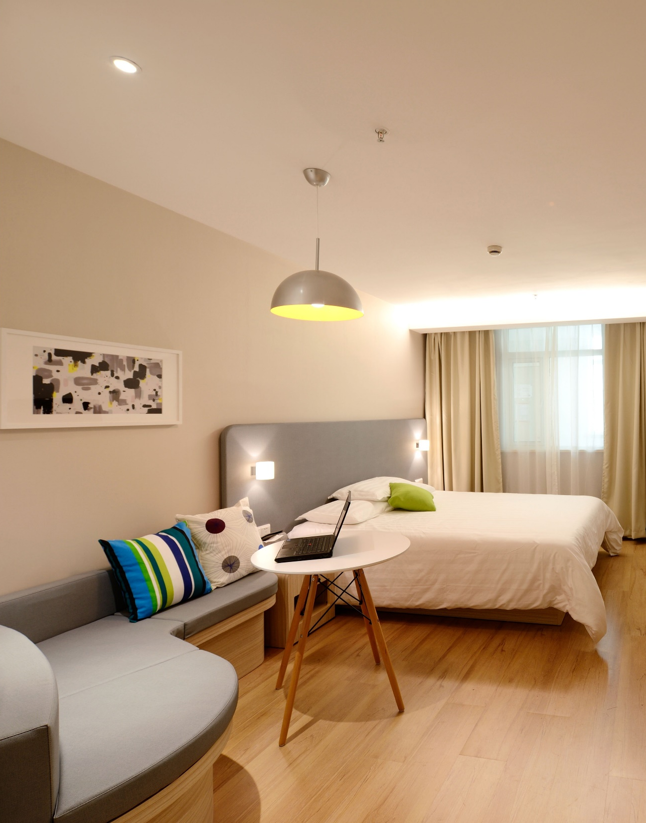

Find My Perfect Airbnb
Capstone Project By Ollie Hanlon
Notes:
Good morning, I am here to present my capstone project: Find my perfect Airbnb, which is all about finding the right Airbnb for you quicker and easier.

Slide 2
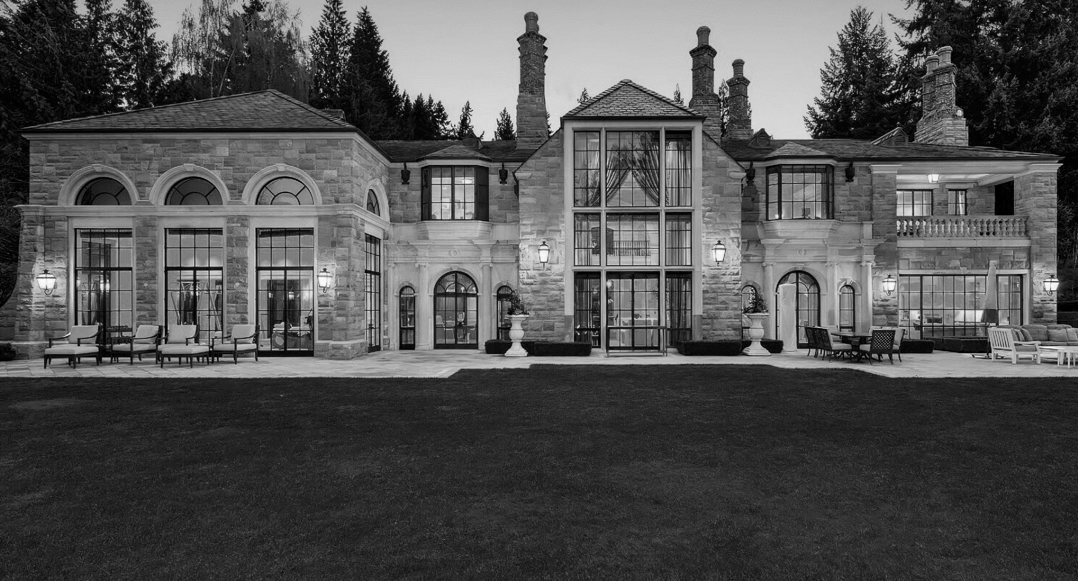

The Background
Notes:
Before I jump in the solution, I would like to talk a little bit about the background to the problem. There are 2 main reasons which motivated me to pick this project.

Slide 3
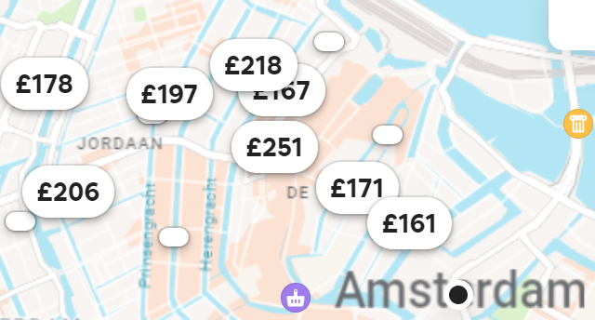

Too much choice
100s
Number of Airbnb listings for a weekend in Amsterdam after filters!
Notes:
The first being an overwhelming number of listings. Even after using airbnb built in filter set to my price range and number of beds, I am still often left with hundreds of listings. I believe a lot of these listings are simply not for me and I want a more tailored search engine.

Slide 4
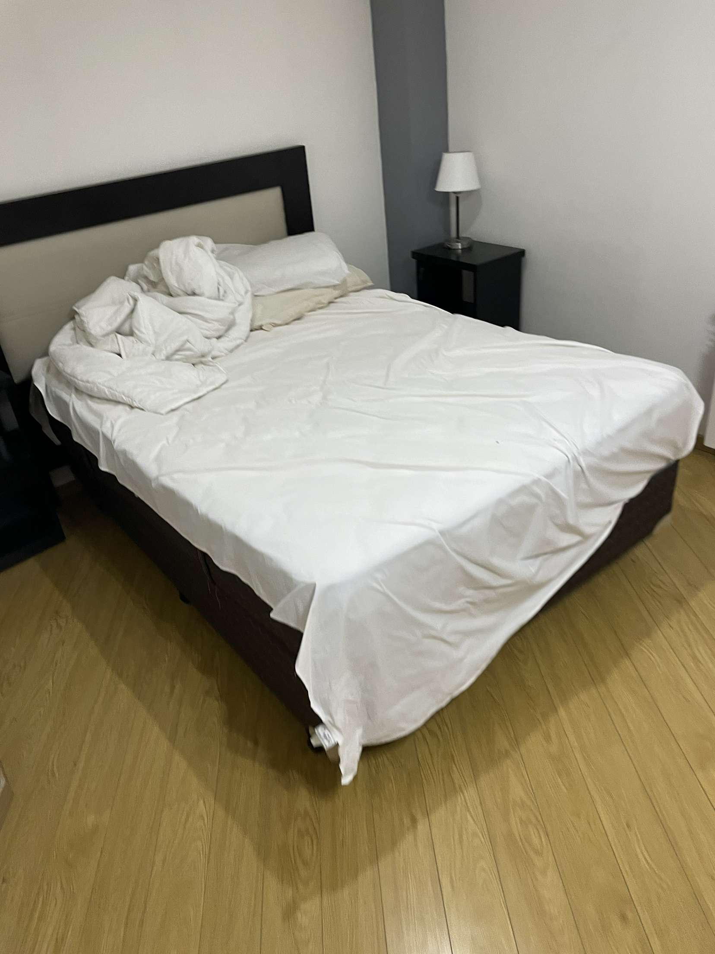
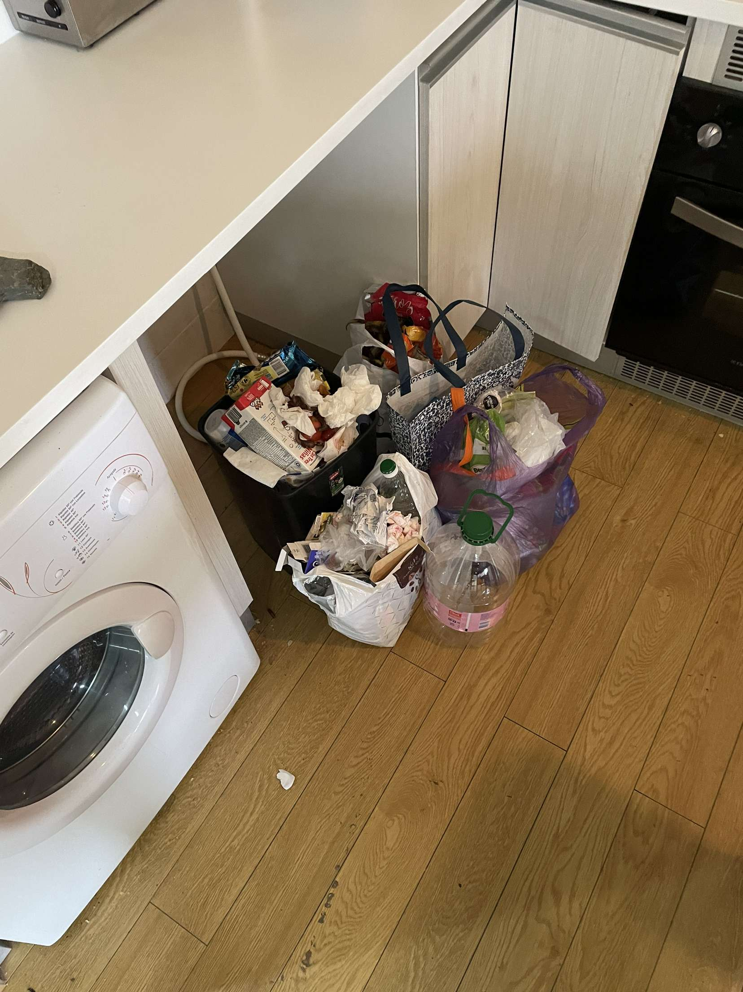
My Awful Airbnb Experience
Notes:
Second reason is due to an awful Airbnb experience I had around a year ago.

Slide 5
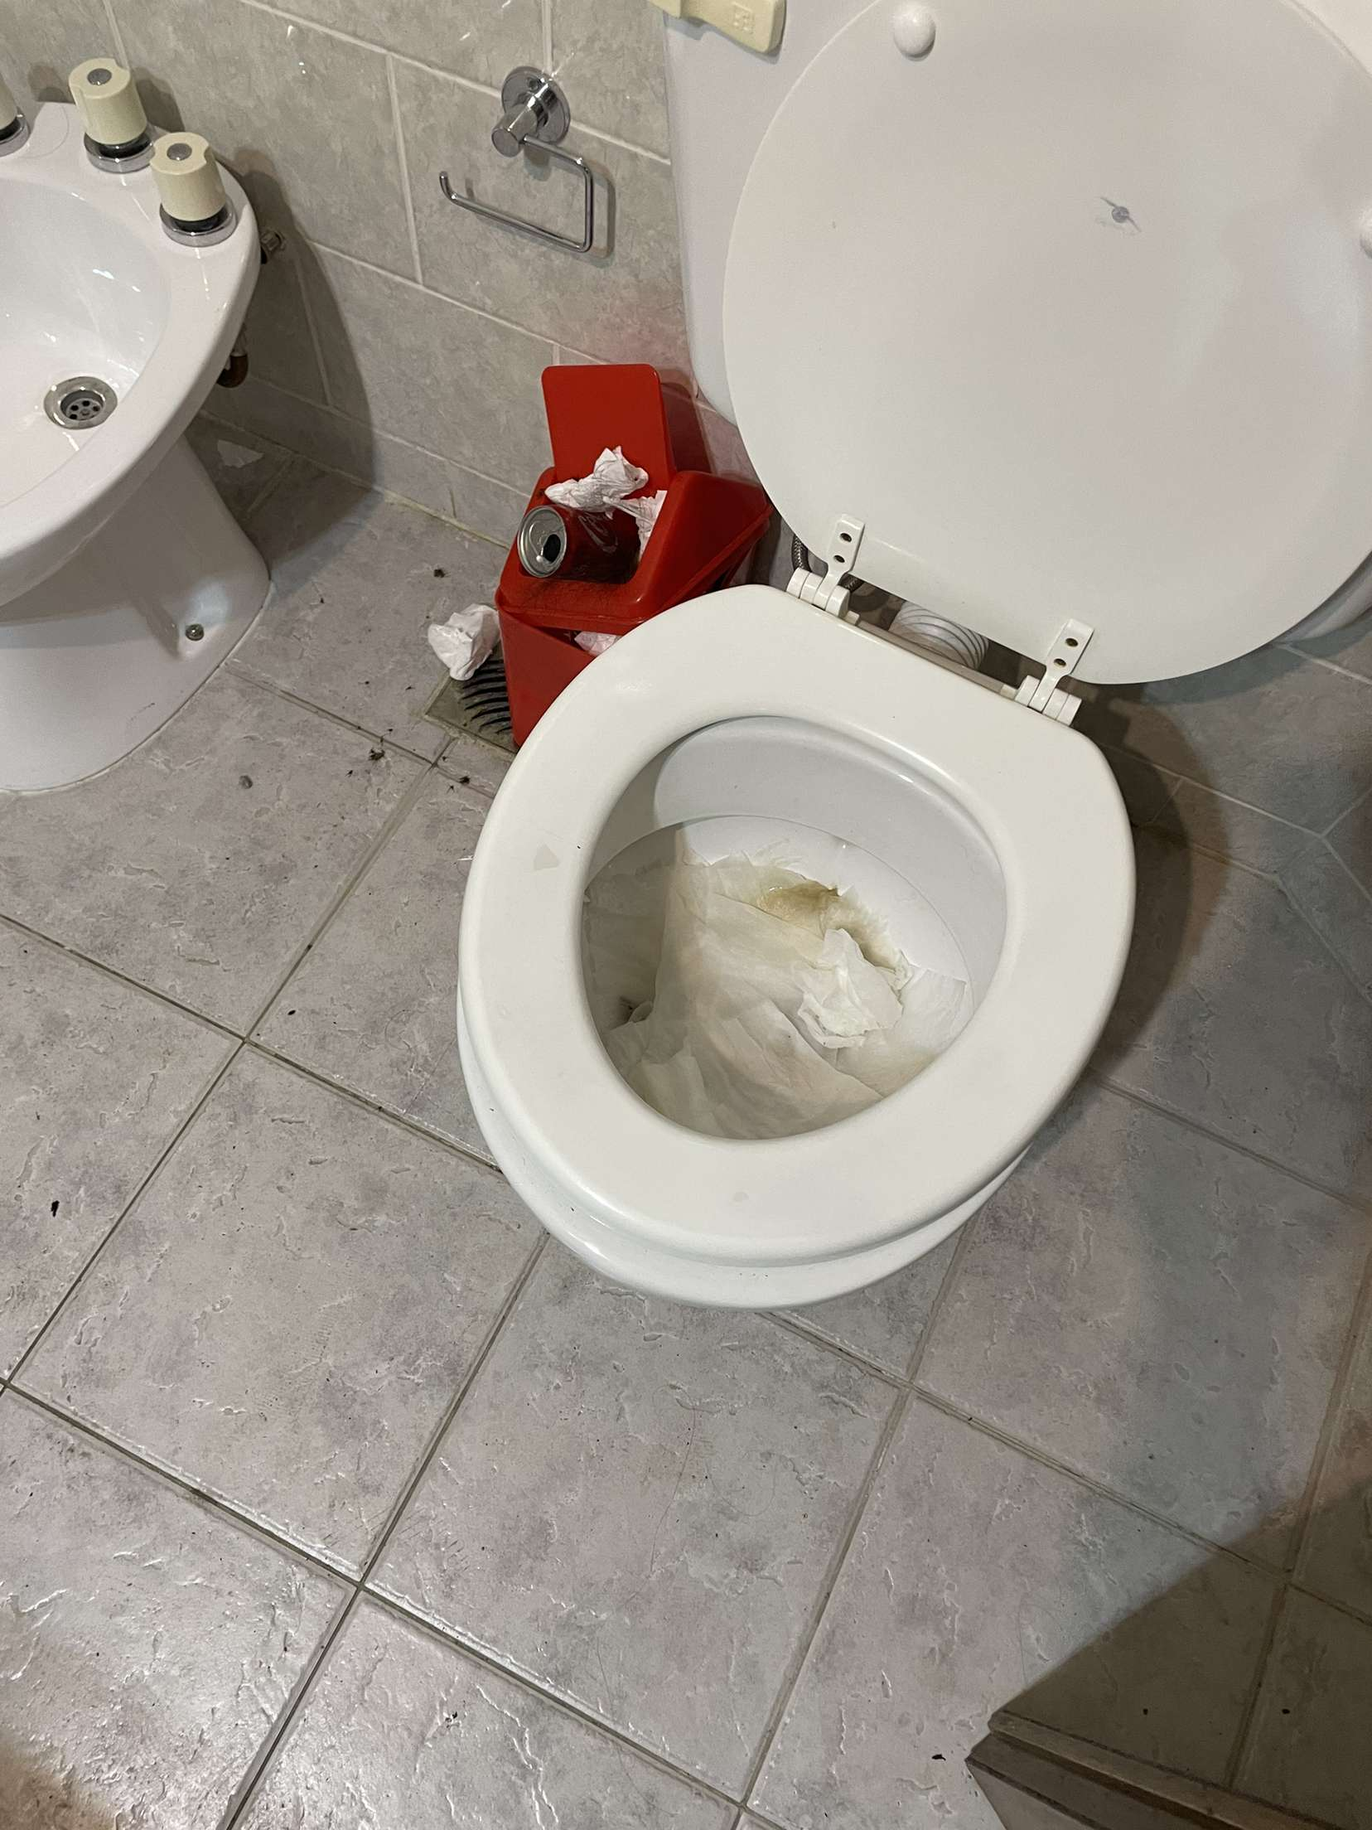
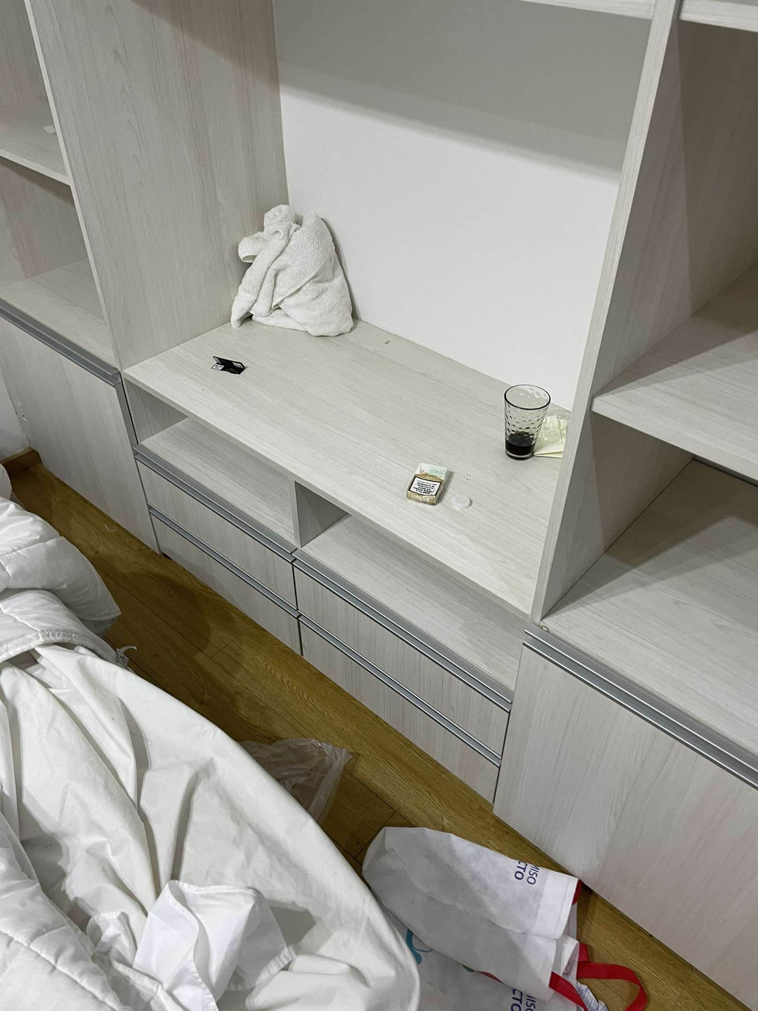
My Awful Airbnb Experience

Slide 6
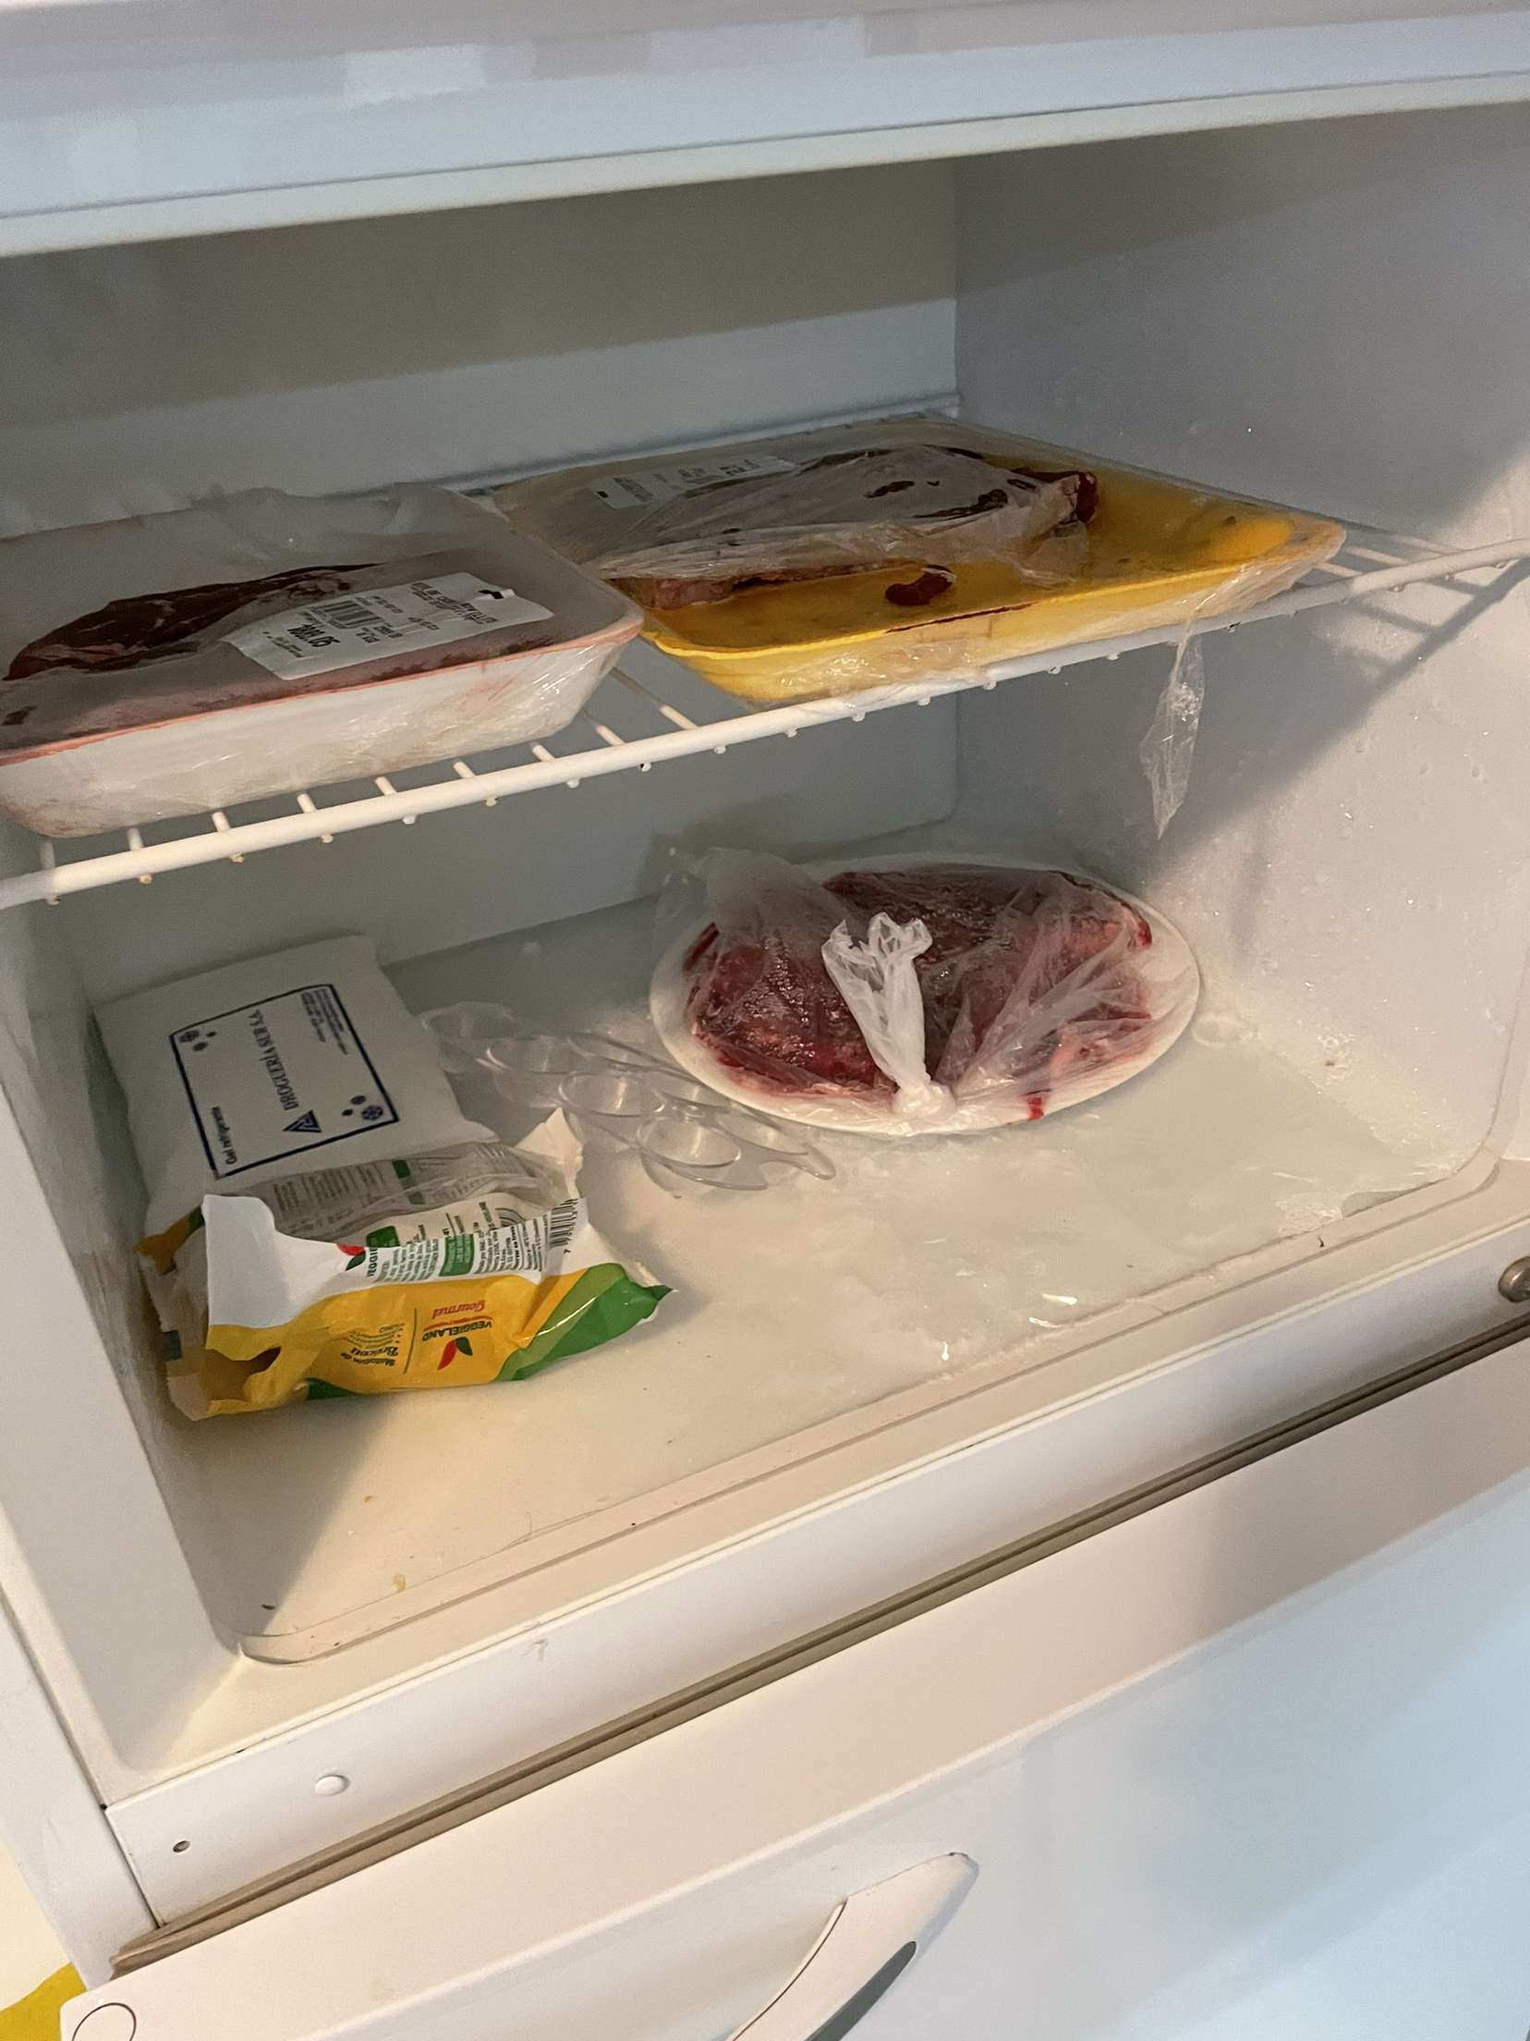
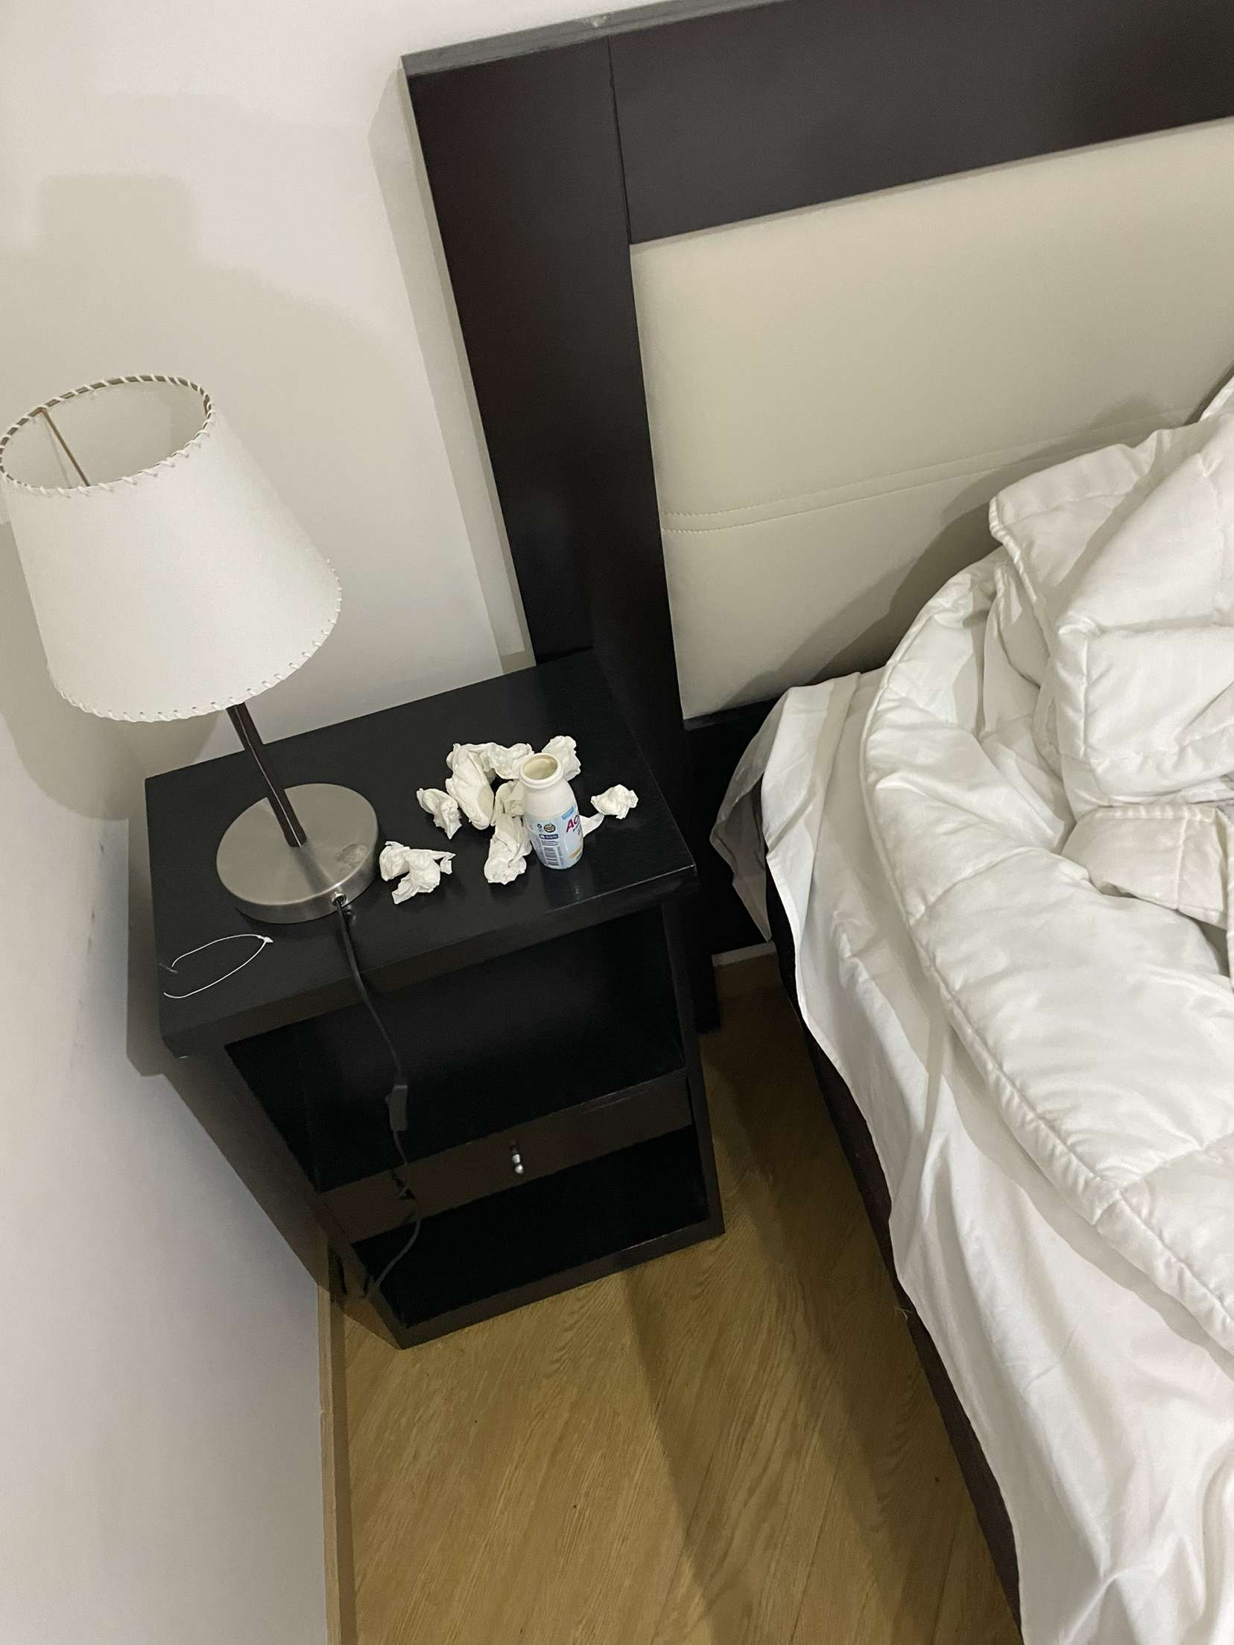
My Awful Airbnb Experience
Notes:
Place had clearly not been cleaned and we were left without an Airbnb. Now, I spend ages reading through reviews to ensure something similar doesn’t happen again, adding even more time in my search for the perfect Airbnb

Slide 7



The Solution
Analyse the descriptions of Airbnb listings to filter upon key themes
Analyse the reviews to avoid bad listings
Advanced filter to find relevant Airbnb Listings
Notes:
So, to solve these problems I wanted a more advanced filtering system. I did this by gouping listings into categories based upon characteristics found in their listing descriptions and established listings which had lots of bad reviews. Then, created a function to filter upon the users desiredpreferences,

Slide 8
The Data Set
Notes:
Before, I could work on my solution, it was time to find an appropriate data set.

Slide 9
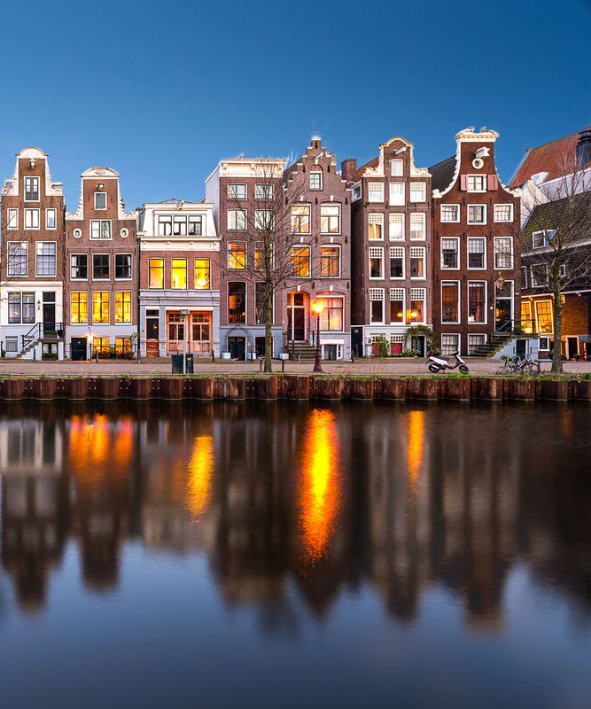
Data Set Containing Every Listing in Amsterdam
Reviews
Listing Details
20000 Listings
Approximately 200 reviews per listings
Notes:
Data sets from Kaggle containing every live Airbnb listing back in June 2018. The first data set contained comprehensive details about the listings from the price per night all the way to the description and summary of that listing. The Next data set was the reviews which had approxitmeyl 200 reviews per listings

Slide 10
Exploring Key Themes
Notes:
Now I had the data, it was time to explore key trends

Slide 11
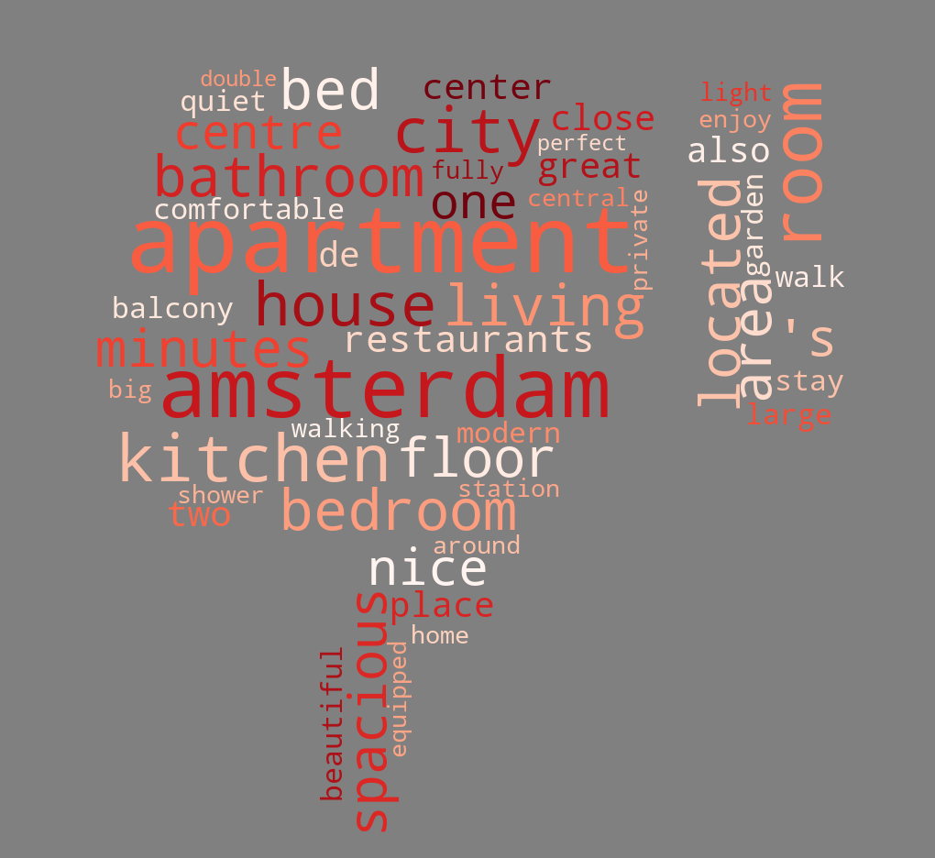
No Value Words
Most common words found in the listing descriptions
Majority of these words don’t add any unique value
Notes:
Looking at the listings data set, I wanted to count the most common words within the descriptions and summary. As you can see, lots of these words don’t really tell anything unique about the listing. Some of the most popular words being Amsterdam and apartment which don’t tell us anything personal about that airbnb

Slide 12
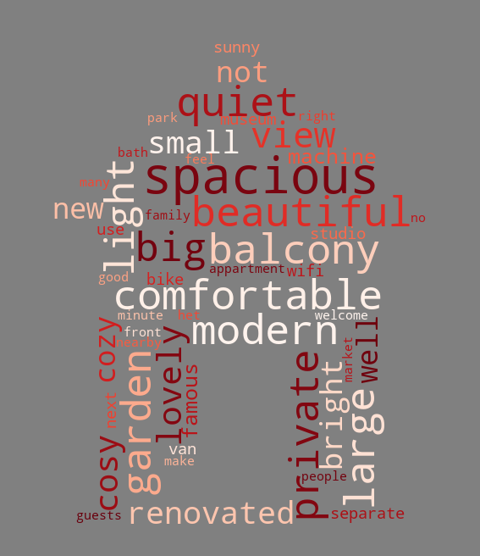
Words Which Add Value
Most common words which add value
Notes:
After creating a long list of words which I deemed to add no value, I counted the most common words again and was left with this word cloud. Now I was left with important words which better describe the characteristics of the airbnb

Slide 13
“Natural Language Processing Is My Favourite Thing”
Alex Caian
Notes:
The next step was to do some data cleaning, otherwise called natural language processing.

Slide 14
Bigram Model:
Text Processing
Tokenisation:
that is not clean
that
+
is
+
not
+
Clean
that is not clean
that
+
is
+
not clean
Notes:
Before modelling could be done, a process called tokenisation was used, which splits a sentence into individual components. However, this can take away the value of having 2 words togethers. Therefore, I created a bigram model which took a list of words such as ‘not’ and’no’ which if detected combined the token after it into two, as seen in this example leaving the bigram token, ‘not clean’

Slide 15
Stemmer
Lighting
Stemming was required to reduce words to their root form
Lights
Light
Porter stemmer was used due to its simplicity and speed
Light
Notes:
The next step was to stem the words back to their original root. As you can see from this example, the words lighting, lights and light all have the root meaning. It is important to deal with this to detect clear themes in texts The stemmer I chose was the porter stemmer due to its simplicity and speed. I wanted my model to run quickly due to the size of the datasets

Slide 16
Modelling
Notes:
Finally, I was at the stage where I could start doing modelling. I started with the listing data set and wanted to see if I could group Airbnb into distinct categories based upon their description

Slide 17
Topic Modelling
https://d.docs.live.net/1b5feb151a351e4e/Documents/Digital%20Futures/Capstone%20Project/archive/lda_result.html
Notes:
The first model I looked at was topic modelling. This is an unsupervised learning technique which attempts to find patterns of co occurring words and group them into topics. My model is in HTML display so I will just have to leave PowerPoint quickly.

Slide 18
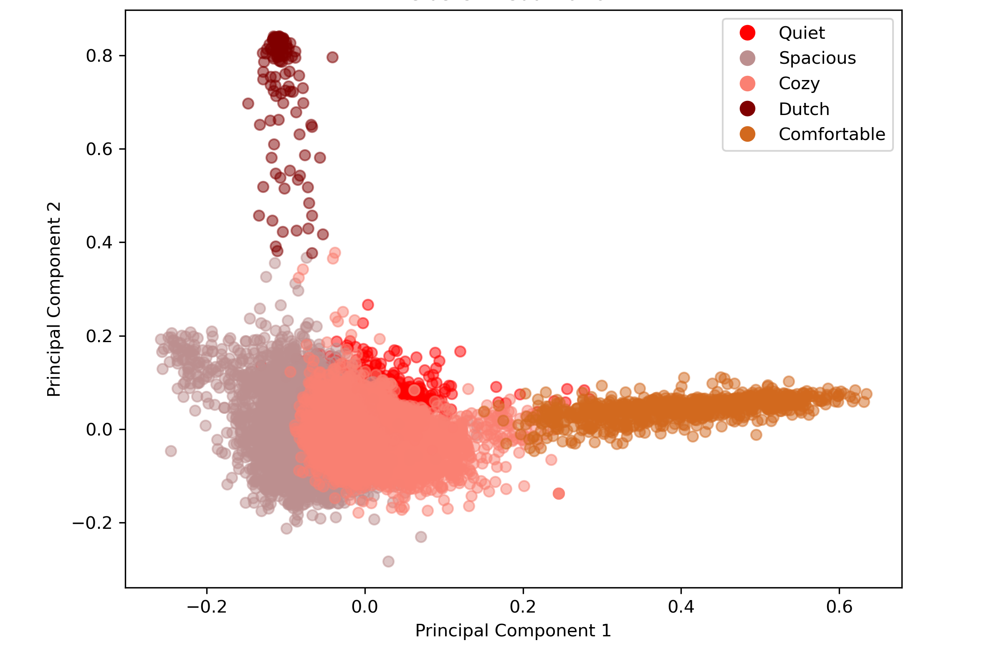
K-means Model
Notes:
The next model I looked at was a k-means clustering model. This is again an unsupervised learning model which can be used to cluster text data. You can see in the legend the most common word associated in each cluster.

Slide 19
Most Common Words in Each Cluster
2: Dutch
|een|
|het|
|met|
|van|
|mijn|
3: Cozy
1: Quiet
|quiet|
|private| |balcony| |park| |view|
|studio| |small|
|cozy|
love view
|spacious| |garden| |large|
|big|
|light| |family|
5: Comfortable
|comfort| |sleep| |warm| |inviting|
4: Spacious
Notes:
Taking a look at the most common words of each cluster in more detail, you can see the model has grouped listings into more distinct categories with words more closely related. I was happy with this model and decided to take it forward.

Slide 20
Reviews
Notes:
Now that I had dealt with the listings data set, it was time to look at the reviews.

Slide 21
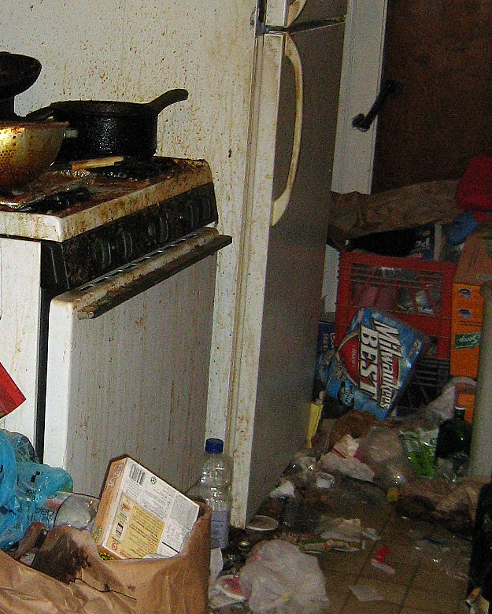
Using bigrams and other key words to detect bad reviews
|no clean|
|not clean|
|dirty|
|gross|
|bad|
|not good|
|not nice|
Capture percentage of reviews for a listing which contain the following words
Notes:
I created a simple model which looked for appearances of words or phrases such as not clean, dirty or gross, which you would expect to find in a negative review. Since every listing had a different number of reviews, I scored each Airbnb on the number of bad reviews divided by the total number of reviews for that listings

Slide 22
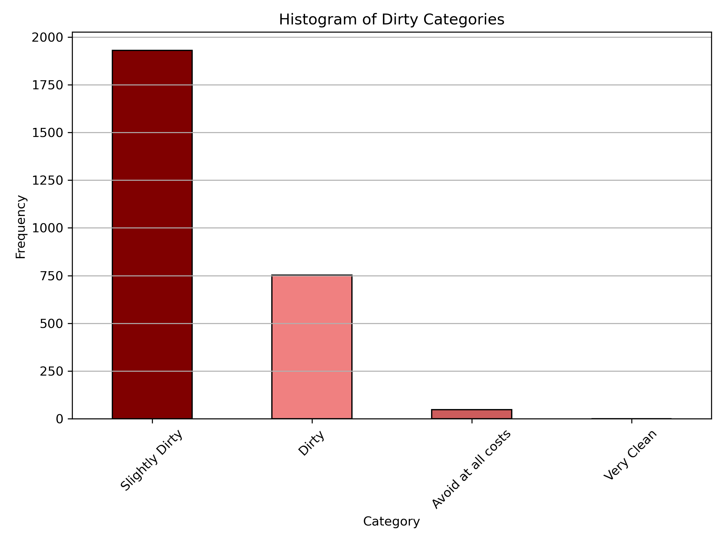
Histogram of Different Cleanliness Categories
80% of listings were not captured by this model and assumed to be very clean
Listings grouped in ‘cleanliness categories’
Notes:
These scores were then bucketized into the categories seen on this figure. This histogram only displays listings which were flagged with negative reviews, with 80% of the listings evading my negative review model and were labelled as very clean.

Slide 23
Reviews from the ‘Dirtiest’ Listing
Very small room, dirty, just like the bathroom (that the owner also uses...). There was a rat in the room and wind was coming through the window. The location was nice however.
Not ideal for 2 people. The room was like staying in a cell. Not clean at all. Our shared bathroom was dark and small, the shower did not have proper door... this resulted in flooding the floor with water. Buy a curtain rod and put up a curtain! And the check in process was terrible. Agnes is a nice person but w would never stay here again.

Slide 24
Final Function

Slide 25
Final Thoughts
Notes:
While I was happy with my how my final model and function performs, I believe there is still a lot of room for improvement.

Slide 26
Final Thoughts
Infinite amount more natural language processing could be done
Model Improvements to establish better clusters
Final function adjustments
Notes:
Infinite amount more natural language processing could be done to remove more no value words and establish better bigrams to improve model performance. There could also be lots more work done into tweaking the models to create better clusters and perhaps even a greater number of clusters. Finally, my function could be improved to be made a lot more user friendly. Overall, with a problem like this I believe there will always be room for improvement.

Slide 27
Thankyou for Listening
Notes:
That’s all from me, I hope you enjoyed listening.

